Slide 1
DATA STRUCTURES AND ALGORITHM
Graphs
Lecture No. 15

Slide 2
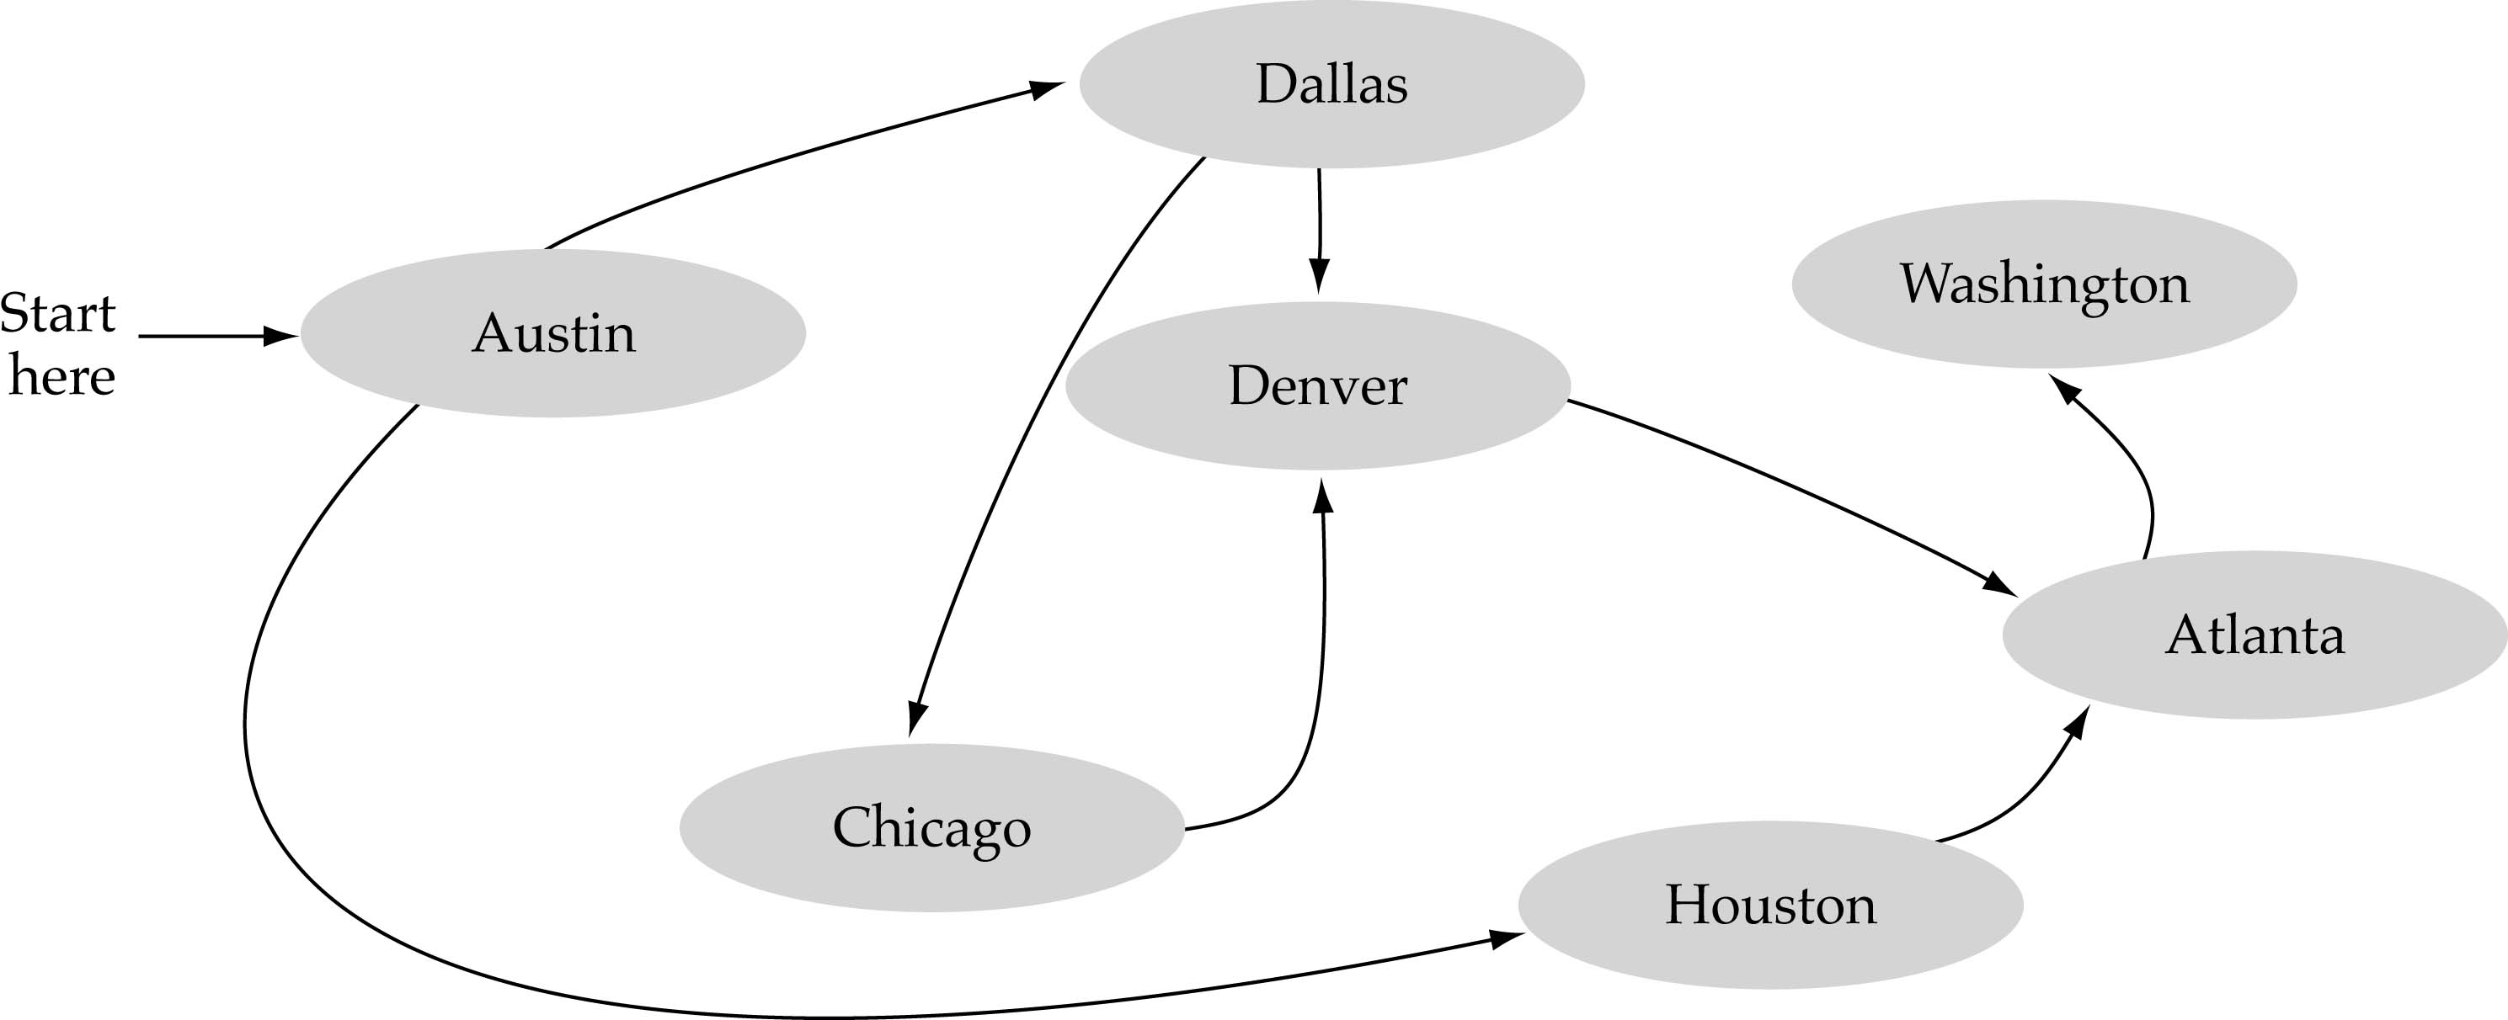
What is a graph?
A data structure that consists of a set of nodes (vertices) and a set of edges that relate the nodes to each other.
The set of edges describes relationships among the vertices.

Slide 3
Formal definition of graphs
A graph G is defined as follows:
G=(V,E)
V(G): a finite, nonempty set of vertices
E(G): a set of edges (pairs of vertices)

Slide 4
Applications
electronic circuits
CS16
JFK
LAX
LAX
STL
networks (roads, flights, communications)
HNL
DFW
FTL

Slide 5
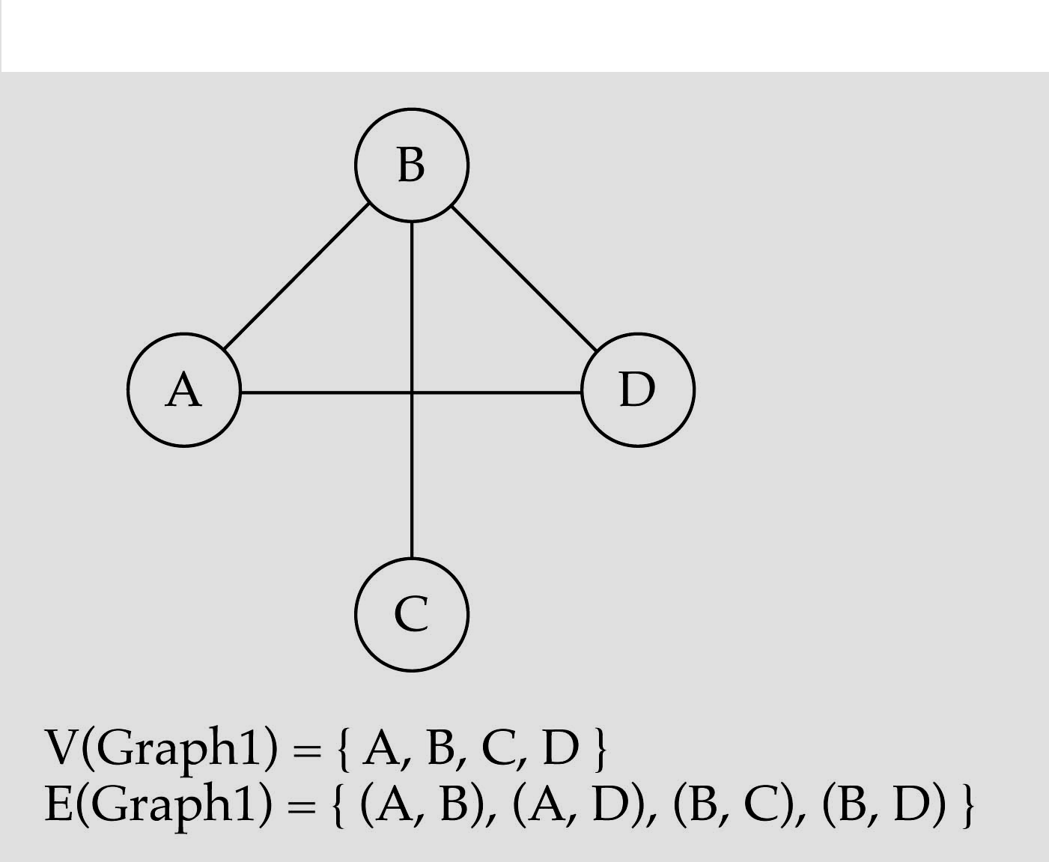
Directed vs. Undirected Graphs
When the edges in a graph have no direction, the graph is called undirected

Slide 6
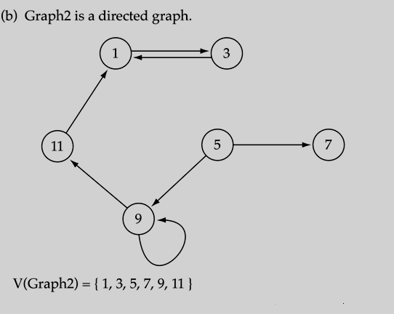
Directed vs. Undirected Graphs
When the edges in a graph have a direction, the graph is called directed (or digraph)
if the graph is directed, the order of the vertices in each edge is important !!
E(Graph2) = {(1,3), (3,1), (5,9), (9,11), (5,7), (11,1), (9,9)

Slide 7
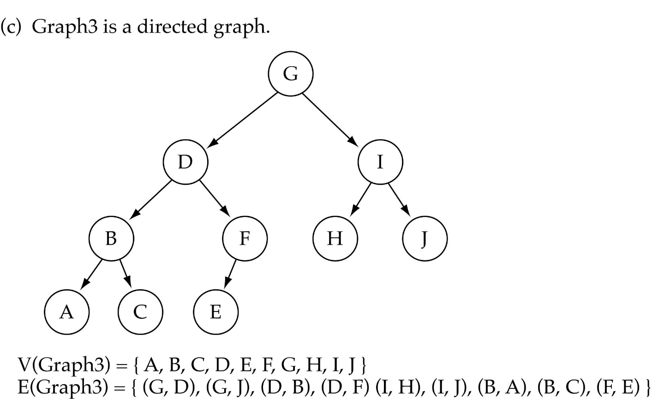
Trees vs Graphs
Trees are special cases of graphs!!

Slide 8
Graph Terminology
The length of a path in graph is the number of edges, equals to n-1.
A path from a vertex to itself has length 0.
Path(v,v) is referred to as a loop.
When all vertices are distinct, except that the first and the last could be the same, it is Simple Path.
A cycle in a directed graph is a path of length at least 1, such that w₁ = w_{n}.

Slide 9

Graph Terminology
Adjacent nodes: two nodes are adjacent if they are connected by an edge
If (v0, v1) is an edge in an undirected graph,
  v0 and v1 are adjacent
  The edge (v0, v1) is incident on vertices v0 and v1
If <v0, v1> is an edge in a directed graph
  v0 is adjacent to v1, and v1 is adjacent from v0
  The edge <v0, v1> is incident on v0 and v1
5 is adjacent to 7
7 is adjacent from 5

Slide 10
Graph Terminology
Path:
  A sequence of vertices that connect two nodes in a graph
  A sequence of vertices v₁,v₂,. . .v_{k} such that consecutive vertices v_{i} and v_{i+1} are adjacent.
a
b
a
b
c
c
d
e
d
e
a b e d c
b e d c

Slide 11
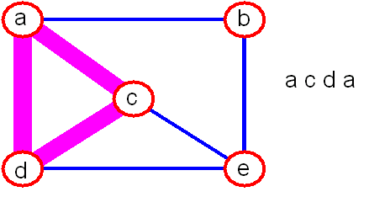
Graph Terminology
simple path: no repeated vertices
cycle: simple path, except that the last vertex is the same as the first vertex
a
b
b e c
c
d
e

Slide 12
Graph Terminology
The degree of a vertex is the number of edges incident to that vertex
For directed graph,
  the in-degree of a vertex v is the number of edges
  that have v as the head
  the out-degree of a vertex v is the number of edges that have v as the tail

Slide 13
Example
3
0
0
2
1
2
3
1
2
3
3
3
3
3
4
5
6
3
G1
0
in:1, out: 1
1
1
1
1
G2
1
in: 1, out: 2
2
in: 1, out: 0
G3

Slide 14
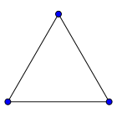
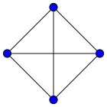
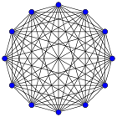
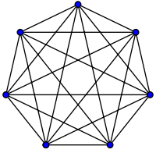
Graph Terminology
Complete graph: a graph in which every vertex is directly connected to every other vertex

Slide 15
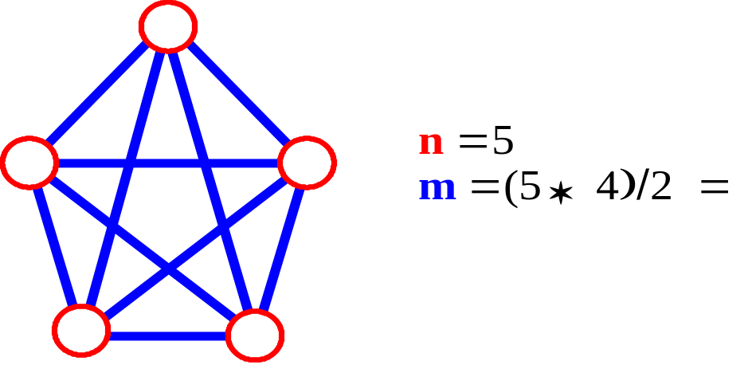
Graph Terminology
Let n = #vertices, and m = #edges
A complete graph: one in which all pairs of vertices are adjacent
How many total edges in a complete graph?
  Each of the n vertices is incident to n-1 edges, however, we would have counted each edge twice! Therefore, intuitively, m = n(n -1)/2.
Therefore, if a graph is not complete, m < n(n -1)/2

Slide 16
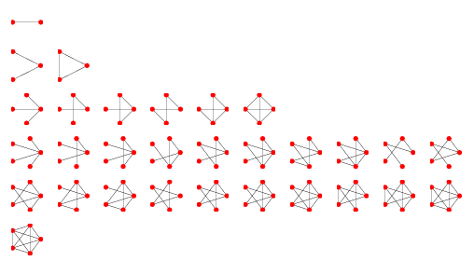
Graph Terminology
Connected Graph: a graph in which there is a path from any point to any other point in the graph. A graph that is not connected is said to be disconnected.

Slide 17
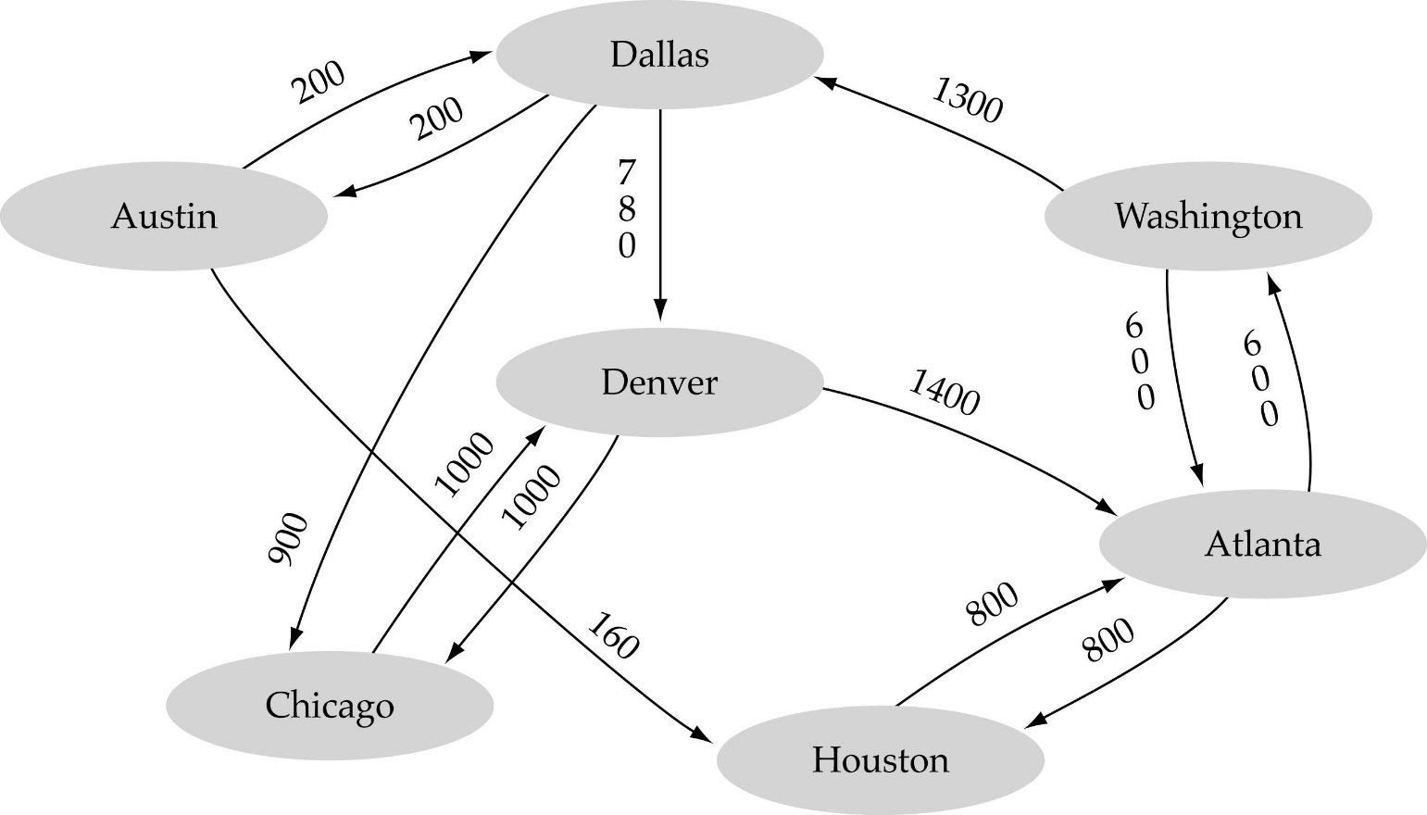
Graph Terminology
Weighted graph: a graph in which each edge carries a value

Slide 18

Static Graph implementation
Array-based implementation
  A 1D array is used to represent the vertices
  A 2D array (adjacency matrix) is used to represent the edges

Slide 19
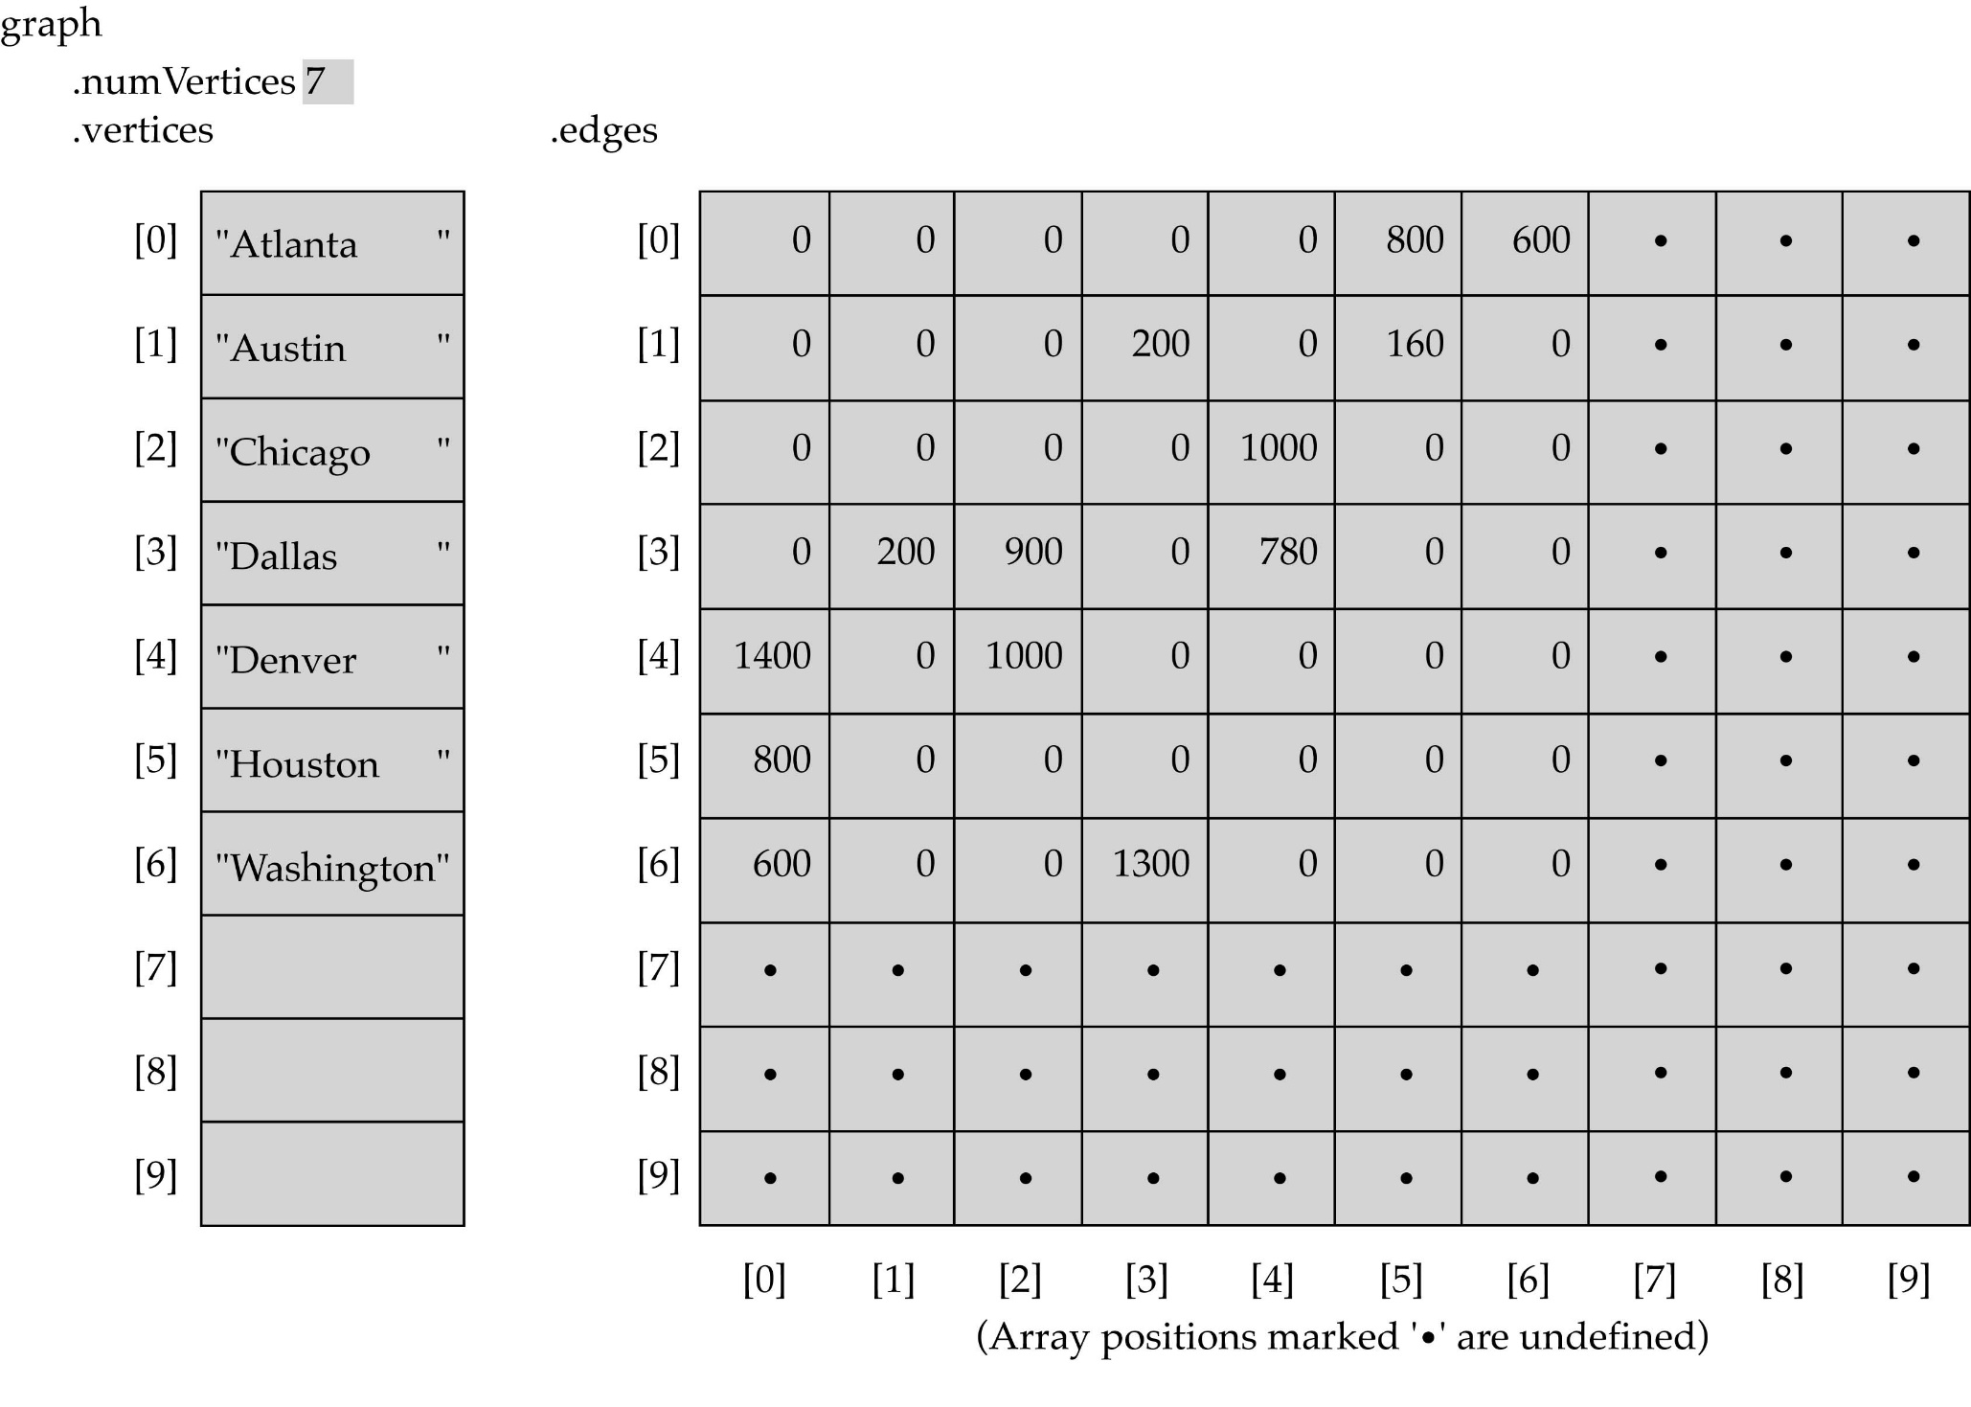
Array-based implementation

Slide 20
Adjacency Matrix
1
2
4
5
3
6
7

Slide 21
Adjacency Matrix
 | 1 | 2 | 3 | 4 | 5 | 6 | 7
1 | 0 | 1 | 1 | 1 | 0 | 0 | 0
2 | 0 | 0 | 0 | 1 | 1 | 0 | 0
3 | 0 | 0 | 0 | 0 | 0 | 1 | 0
4 | 0 | 0 | 1 | 0 | 0 | 1 | 1
5 | 0 | 0 | 0 | 1 | 0 | 0 | 1
6 | 0 | 0 | 0 | 0 | 0 | 0 | 0
7 | 0 | 0 | 0 | 0 | 0 | 1 | 0

Slide 22
Static Implementation
class SGraph
{
private:
int noOfVertices;
Bool *aMatrix;
public:
SGraph(int nv) //creates adjacency matrix to represent graph.
{
noOfVertices = nv;
// creates rows of two dimensional array on runtime aMatrix = new Bool *[noOfVertices];
//creates columns of two dimensional array on runtime
for(int i = 0; i<noOfVertices; i++)
aMatrix[i] = new Bool[noOfVertices];
}

Slide 23
Static Implementation
public:
insertGraph() //inserts graph in adjacency matrix
{
char choice;
for(int i = 0; i<noOfVertices; i++)
for(int j = 0; j<noOfVertices; j++)
{ cout<<“is there an edge b/w vertex”<<i<<“and”<<j;
cin>>choice;
if(choice == ‘y’ || choice == ‘Y’)
aMatrix[i][j] = 1;
else
aMatrix[i][j] = 0;
}
}
};

Slide 24

Graph implementation (cont.)
Linked-list implementation
  A 1D array is used to represent the vertices
  A list is used for each vertex v which contains the vertices which are adjacent from v (adjacency list)

Slide 25
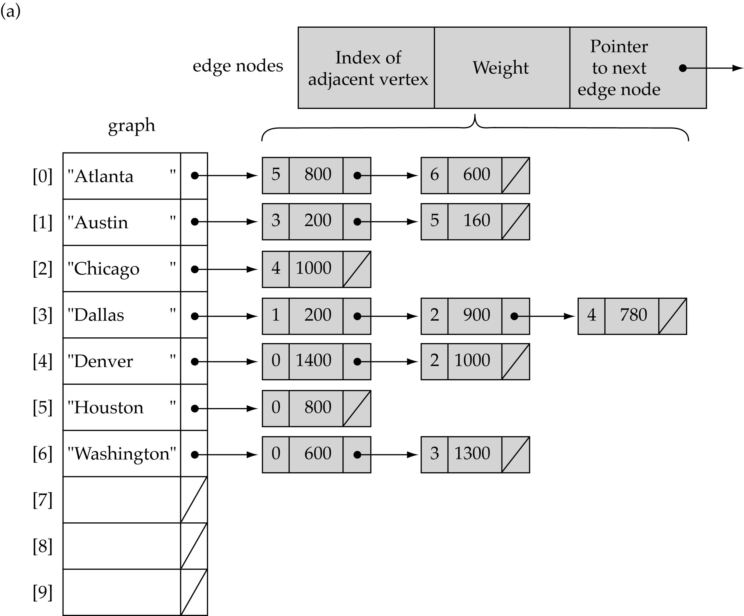
Linked-list implementation

Slide 26
Dynamic Implementation
public class DGraph
{
private:
int noOfVertices;
LinkedList *aList;
public:
//creates adjacency list to represent graph
DGraph(int nv)
{
noOfVertices = nv;
aList = new LinkedList[noOfVertices];
}
Continue on next slide…

Slide 27
Dynamic Implementation
//inserts graph in adjacency list
insert()
{ for(int i = 0; i<noOfVertices; i++)
{ int vertexNo;
cout<<“Enter the number of vertex adjacent to vertex” <<i<<“Enter –1 to terminate”;
cin>>vertexNo;
while(vertexNo != -1)
{ aList[i].addToTail(vertexNo);
cin>>vertexNo;
}
}
}
};

Slide 28
Adjacency Matrix vs. Adjacency List representation
Adjacency matrix
  Good for dense graphs
  Connectivity between two vertices can be tested quickly
Adjacency list
  Good for sparse graphs
  Vertices adjacent to another vertex can be found quickly

Slide 29
Print All the nodes of a graph
Apply one of the tree traversal technique (Pre, In, Post Order)
1
2
4
5
3
6
7

Slide 30
Graph searching
Problem: find a path between two nodes of the graph (e.g., Austin and Washington)
Methods: Depth-First-Search (DFS) or Breadth-First-Search (BFS)

Slide 31
Graph Traversals
Traversing a graph consists of visiting each vertex only one time.
We can traverse the graph by two ways:
  Depth first search
  Breadth first search

Slide 32
Graph Traversals (Depth first search)
This strategy proceeds along a path from vertex v as deeply into the graph as possible.
This means that after visiting v, the algo tries to visit any unvisited vertex adjacent to v.
When the traversal reaches a vertex which has no adjacent vertex, it back tracks and visits an unvisited adjacent vertex.
Stack can be used to help in back tracking.
Similar to Preorder Tree Traversal.

Slide 33
Depth first search
v
u
w
x
q
t
r
s
vuqrstwx

Slide 34
Graph Traversals (Depth first search algorithm)
Declare an array visited of type Boolean and initialize it to false.
Each index of this array indicates whether a particular vertex is visited or not.

Slide 35
Depth first search algorithm
depthFirstSearch(int TotalVertices)
{
boolean *visited = new int[TotalVertices];
for(int i = 0; i < TotalVertices; i++)
visited[ i ] = false;
while there is a vertex v which is not visited
DFS(v, visited)
}

Slide 36
Depth first search algorithm
DFS(Vertex v, Boolean visited[ ])
{ Stack s;
s.push(v);
visited[v] = true;
while(!s.isempty())
{ if(no adjacent vertices exist)
v = s.pop();
else
{ for each unvisited vertex u adjacent to v
s.push(u);
visited[u] = true;
}
}
};

Slide 37
Issues
DFS does not specify the order in which adjacent nodes should be visited.
Visit the vertices adjacent to v in alphabetical order.

Slide 38
Graph Traversals (Breadth first search)
It is basically a level order traversal.
After visiting a given vertex v, this strategy visits every vertex adjacent to v at the same level.
Traverses the graph in breadth, from left to right.
Queue is used to keep track of the nodes/vertices.

Slide 39
Graph Traversals (Breadth first search)
v
u
w
x
q
t
r
vuwxqtrs
s

Slide 40
Breadth first search algorithm
BFS(Vertex v)
{
Add V to Queue & mark it visited
While (Queue not Empty)
{ Remove Vertex from Queue & call it w
for (each unvisited vertex u adjacent to w) mark w visited
add u in Queue
}
End
}

Slide 41
Breadth First Traversal Example
A
C
D
B
E
I
H
F
G

Slide 42
Breadth First Traversal Example
Queue
A
C
B
C
D
B
E
I
H
F
G

Slide 43
Breadth First Traversal Example
Dqueue C
A
B
C
D
B
E
I
H
F
G

Slide 44
Breadth First Traversal Example
Enqueu D
A
B
D
C
D
B
E
I
H
F
G

Slide 45
Breadth First Traversal Example
Dqueue B
A
D
C
D
B
E
I
H
F
G

Slide 46
Breadth First Traversal Example
Enqueue E, I, H
A
D
E
I
H
C
D
B
E
I
H
F
G

Slide 47
Breadth First Traversal Example
Dqueue D
A
E
I
H
C
D
B
E
I
H
F
G

Slide 48
Breadth First Traversal Example
Dqueue E
A
I
H
C
D
B
E
I
H
F
G

Slide 49
Breadth First Traversal Example
Enqueue F, G
A
I
H
F
G
C
D
B
E
I
H
F
G

Slide 50
Breadth First Traversal Example
Dqueue I
A
H
F
G
C
D
B
E
I
H
F
G

Slide 51
Breadth First Traversal Example
Dqueue I
A
H
F
G
C
D
B
E
I
H
H already in queue i.e. visited
F
G

Slide 52
Breadth First Traversal Example
Dqueue H
A
F
G
C
D
B
E
I
H
F
G

Slide 53
Breadth First Traversal Example
Dqueue F
A
G
C
D
B
E
I
H
F
G

Slide 54
Breadth First Traversal Example
Dqueue G
A
C
D
B
E
I
H
F
G

Slide 55
Applications of Graphs
Topological Sorting
Spanning Trees
Shortest Path
Traveling Salesperson
Four Color Problem

Slide 56
Graph Implementation
Following methods can be defined while implementing a Static or Dynamic Graph:
  void MakeEmpty();
  bool IsEmpty();
  bool IsFull();
  void AddVertex(VertexType);
  void AddEdge(VertexType, VertexType, int);
  void DeleteVertex(VertexType);
  void DeleteEdge(VertexType, VertexType, int);
  void ReplaceVertex(VertexType, VertexType);
  int WeightIs(VertexType, VertexType);
  void ClearMarks();
  void MarkVertex(VertexType);
  bool IsMarked(VertexType);
  void DFS(VertexType);
  void BFS(VertexType);

